Slide 1
Tutorial-2
VHDL Intro
Part-2

Slide 2
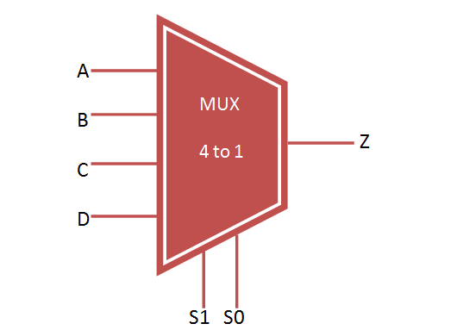
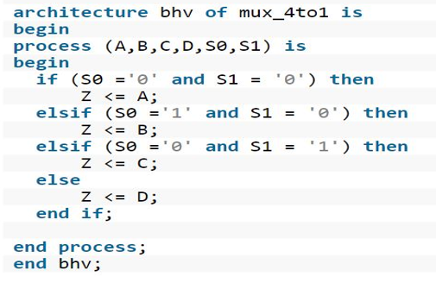
“00”
01
10
11
architecture dataflow of mux_4to1N is
begin
process (A,B,C,D,S0,S1) is
begin
Z <=((NOT S0) AND (NOT S1) AND A) OR ((NOT S0) AND S1 AND B) OR (S0 AND (NOT S1) AND C) OR ( S0 AND S1 AND D);
end process;
end dataflow;

Slide 3
VHDL Structural Model
Specifies what blocks (or components) are used and how they are interconnected.
It is a hierarchical design modelling in which one can define components of units that are used over and over again. This can significantly reduce the complexity of larger design.
VHDL provides a formal way to do this by
Declare a list of components being used
Declare signals which define the netlist (a netlist is a description of the connectivity of an electronic circuit) of interconnected components
Label multiple instances of the declared components so that each instance is uniquely defined.

Slide 4
Architecture Template(Structural)
architecture architecture_name of NAME_OF_ENTITY is
-- Declarations
-- components declarations
-- signal declarations
begin
-- Statements
-- components instantiation and connections
:
end architecture_name;

Slide 5
Component Declaration
component component_name is
port (port_signal_names: mode type;
port_signal_names: mode type;
:
port_signal_names: mode type);
end component component_name;

Slide 6
Component Instantiation and Interconnection
Syntax is as follows:
Label: component _name Port map (signal1, signal2,…, signaln);
Signal positions must be in the same order as the declared component ports.
This method of port signals association is called positional association.

Slide 7
Example: 4-bit adder
B(3)
A(3)
B(2)
A(2)
B(1)
A(1)
B(0)
A(0)
B
A
FA4
FA3
B
A
FA1
B
A
FA2
B
A
C4
Cout
Cin
Cout
Cin
Cout
Cin
Cout
Cin
C0
S
S
S
S
S(3)
S(2)
S(1)
S(0)
A=(0010)
B=(0001)
Sum=0011, carry=_

Slide 8
VHDL Structural Model of 4-bit Adder
library IEEE;
use IEEE.STD_LOGIC_1164.ALL;
entity Ripple_Adder is
Port ( A : in STD_LOGIC_VECTOR (3 downto 0);
B : in STD_LOGIC_VECTOR (3 downto 0);
C0 : in STD_LOGIC;
S : out STD_LOGIC_VECTOR (3 downto 0);
C4 : out STD_LOGIC);
end Ripple_Adder;
architecture Structural of Ripple_Adder is
component full_adder is
Port ( A : in STD_LOGIC;
B : in STD_LOGIC;
Cin : in STD_LOGIC;
S : out STD_LOGIC;
Cout : out STD_LOGIC);
end component;
signal C1,C2,C3: STD_LOGIC;
begin
FA1: full_adder port map( A(0), B(0), C0, S(0), C1);
FA2: full_adder port map( A(1), B(1), C1, S(1), C2);
FA3: full_adder port map( A(2), B(2), C2, S(2), C3);
FA4: full_adder port map( A(3), B(3), C3, S(3), C4);
end Structural ;
B(3)
A(3)
B(2)
A(2)
B(1)
A(1)
B(0)
A(0)
B
A
B
A
FA3
B
A
B
A
FA4
FA2
FA1
C4
Cout
Cin
Cout
Cin
Cout
Cin
Cout
Cin
C0
S
C3
S
C2
S
C1
S
S(3)
S(2)
S(1)
S(0)

Slide 9
VHDL Dataflow Model of Full Adder
library IEEE;
use IEEE.STD_LOGIC_1164.ALL;
entity full_adder is
Port ( A : in STD_LOGIC;
B : in STD_LOGIC;
Cin : in STD_LOGIC;
S : out STD_LOGIC;
Cout : out STD_LOGIC);
end full_adder;
architecture dataflow of full_adder is
begin
S <= A XOR B XOR Cin ;
Cout <= (A AND B) OR (Cin AND A) OR (Cin AND B) ;
end dataflow;
A
B
Cin
Full_adder
S
Cout

Slide 10
FA using Structural VHDL
A
B
Cin
Full_adder
S
Cout

Slide 11
FA using Structural VHDL
A
B
Cin
Full_adder
HA1
HA2
A
S
B
OR1
Cout
Cin
S
Cout

Slide 12
FA using Structural VHDL
A
B
Cin
Full_adder
HA1
HA2
A
X
Sum
X
Sum
S
B
Y
Carry
Y
Carry
P
OR1
Z
Cout
Cin
Q
S
Cout
X
HA
Sum
P
OR_gate
Z
Y
Carry
Q

Slide 13
VHDL Dataflow Model of Half Adder
library IEEE;
use IEEE.STD_LOGIC_1164.ALL;
entity HA is
Port ( X : in STD_LOGIC;
Y : in STD_LOGIC;
Sum : out STD_LOGIC;
Carry : out STD_LOGIC);
end HA ;
architecture dataflow of HA is
begin
Sum <= X XOR Y;
Carry <= (X AND Y) ;
end dataflow;
X
HA
Sum
Y
Carry

Slide 14
VHDL Dataflow Model of OR gate
library IEEE;
use IEEE.STD_LOGIC_1164.ALL;
entity OR_gate is
Port ( P : in STD_LOGIC;
Q : in STD_LOGIC;
Z : out STD_LOGIC);
end OR_gate ;
architecture dataflow of OR_gate is
begin
Z <= P OR Q;
end dataflow;
P
OR_gate
Z
Q

Slide 15
library IEEE;
use IEEE.STD_LOGIC_1164.ALL;
entity Full_adder is
Port ( A : in STD_LOGIC;
B : in STD_LOGIC;
Cin : in STD_LOGIC;
S : out STD_LOGIC ;
Cout : out STD_LOGIC);
end Full_adder ;
architecture Structural of Full_adder is
component HA is
Port ( X : in STD_LOGIC;
Y : in STD_LOGIC;
Sum : out STD_LOGIC;
Carry : out STD_LOGIC);
end component;
component OR_gate is
Port ( P : in STD_LOGIC;
Q: in STD_LOGIC;
Z: out STD_LOGIC);
end component;
signal S1,S2,S3: STD_LOGIC;
begin
HA1: HA port map( A, B, S1, S2);
HA2: HA port map( S1, Cin, S, S3);
OR1: OR_gate port map( S3, S2, Cout);
end Structural ;
S1
A
HA1
HA2
X
Sum
X
Sum
S
B
Y
Carry
Y
Carry
P
S3
OR1
Z
Cout
Cin
Q
S2

